Slide 1
The Otta website
An overview of ottainsurance.co.nz and how to find your way around
FOR OTTA TEAM
Notes:
The Otta website. An overview of ottainsurance.co.nz and how to find your way around.

Slide 2
What this module covers
1
Getting in
2
Finding your way
The preview password while the site is in Coming Soon mode.
The header, main menu, search and the Account login button.
3
Product pages
4
Resources, claims and contact
Product overviews, policy documents and how Apply now works.
Forms and wordings, claims steps, enquiries and the chat.
Notes:
What this module covers. Getting in: The preview password while the site is in Coming Soon mode. Finding your way: The header, main menu, search and the Account login button. Product pages: Product overviews, policy documents and how Apply now works. Resources, claims and contact: Forms and wordings, claims steps, enquiries and the chat.

Slide 3
Getting in
01
While the site is being prepared, every visitor sees a Coming Soon page first.
Notes:
Getting in. While the site is being prepared, every visitor sees a Coming Soon page first.

Slide 4
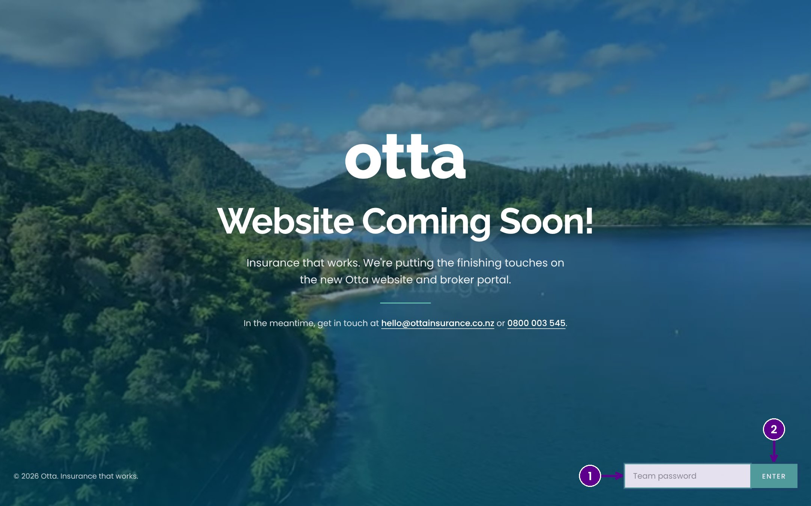
The Coming Soon page
1
Type the preview password. Ask the Otta team if you don't have it.
2
Select Enter to open the full site. You stay signed in on that browser.
Notes:
While Otta prepares for launch, the public website sits behind a Coming Soon page. Anyone with the preview password can see the full site. Type the password and select Enter. Your browser remembers it, so you only do this once per device.

Slide 5
Finding your way
02
Every page shares the same header, so you can always get back to where you need to be.
Notes:
Finding your way. Every page shares the same header, so you can always get back to where you need to be.

Slide 6
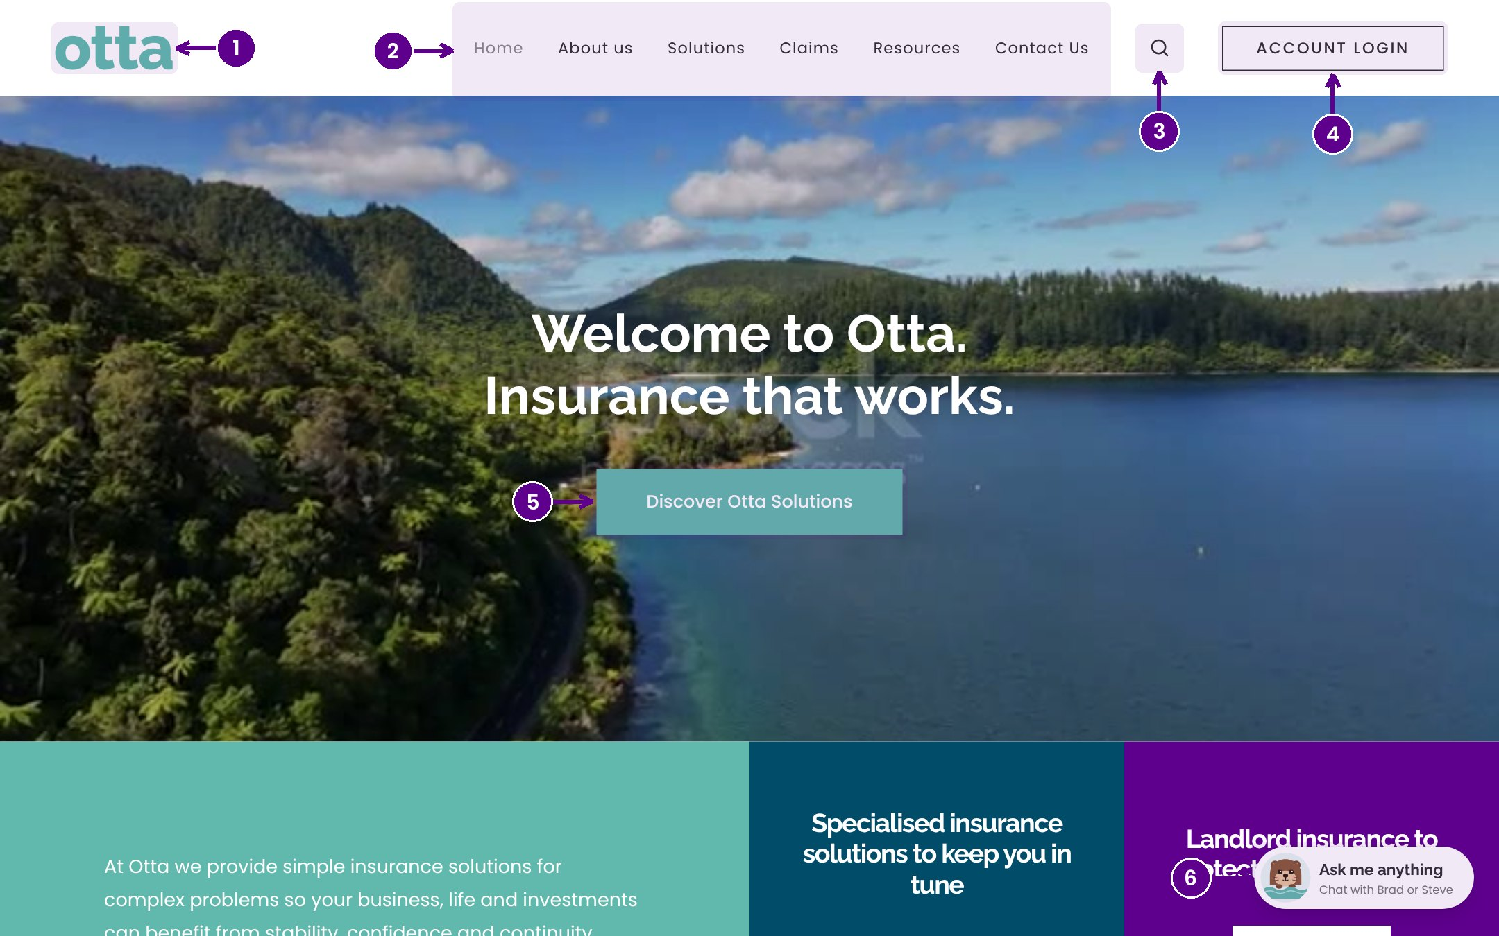
The home page and header
1
The Otta logo takes you back to the home page from anywhere.
2
The main menu: Home, About us, Solutions, Claims, Resources and Contact Us.
3
Search finds products, forms and pages by keyword.
4
Account login takes brokers to the Otta Broker Portal.
5
Discover Otta Solutions jumps straight to our products.
6
Ask the Otta otters: our website chat assistant.
Notes:
This is the home page. The header at the top appears on every page. The logo always brings you home. The main menu holds the six sections of the site. The magnifying glass opens search. Account login is where brokers sign in to the portal. Lower down, Discover Otta Solutions takes visitors to our products, and the otter in the corner opens the chat assistant.

Slide 7
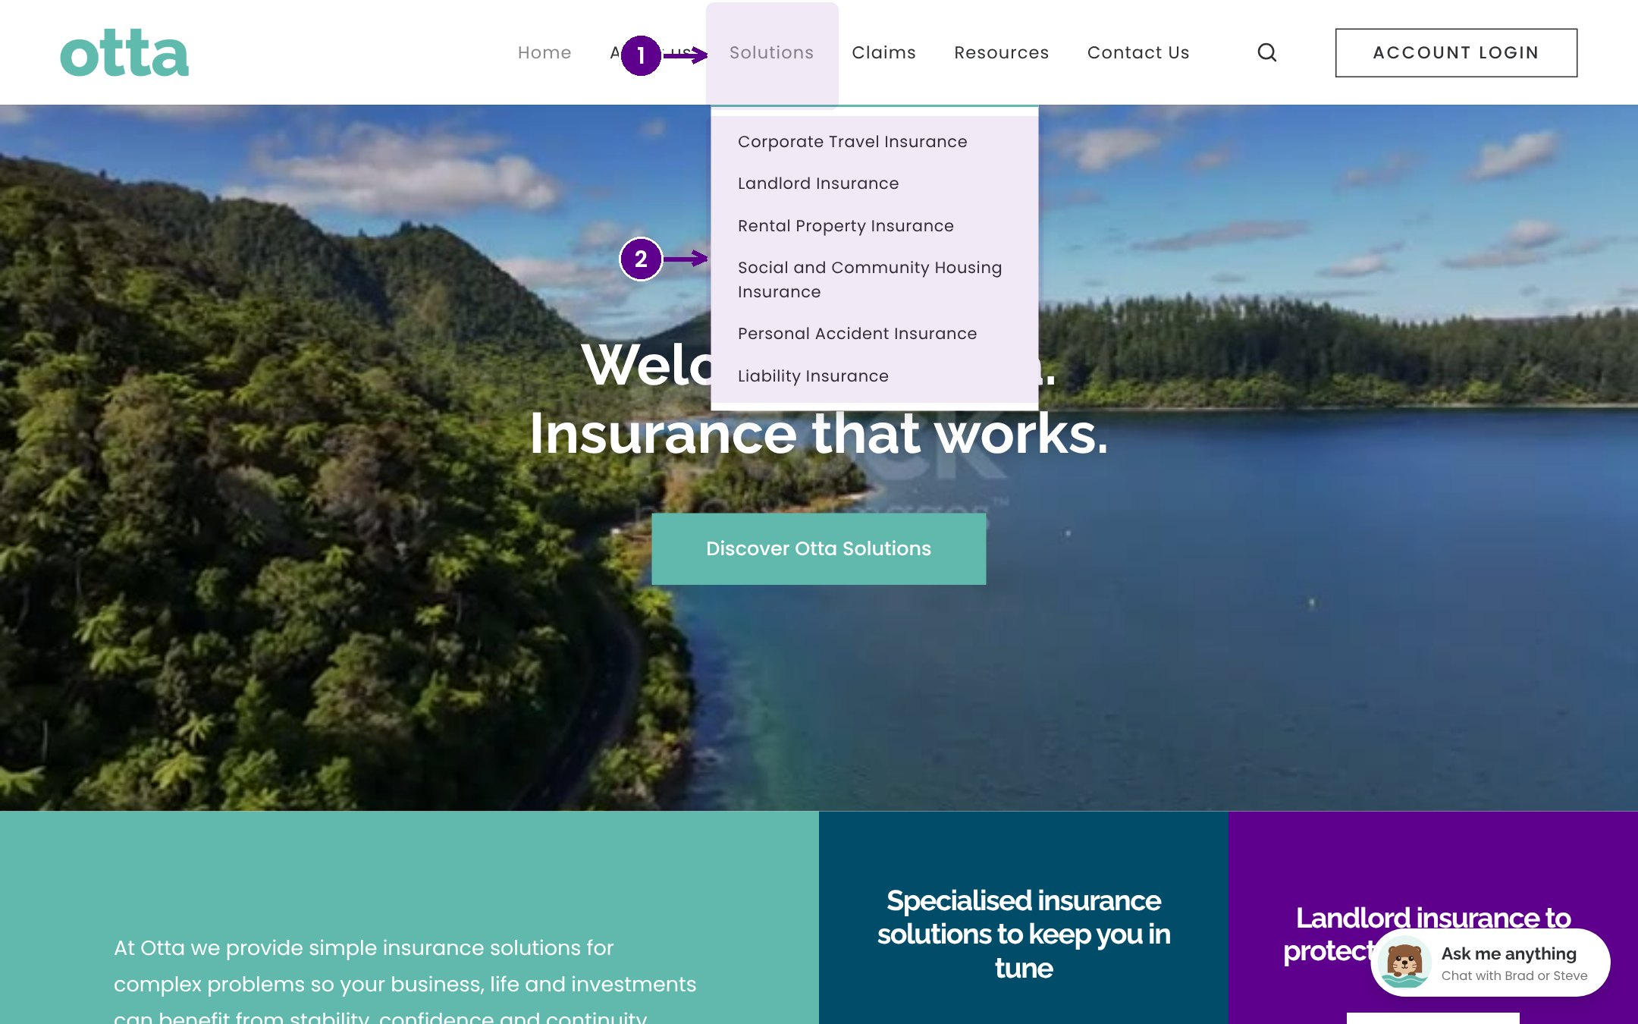
Opening a product from the Solutions menu
1
Hover over Solutions to open the menu.
2
Choose a product to open its page.
Notes:
Hover over Solutions in the main menu and a list of every Otta product appears. Select any product to open its page. On a phone, tap the menu icon instead and the same list appears.

Slide 8
Product pages
03
Each product has its own page with an overview, the key covers and the documents behind it.
Notes:
Product pages. Each product has its own page with an overview, the key covers and the documents behind it.

Slide 9
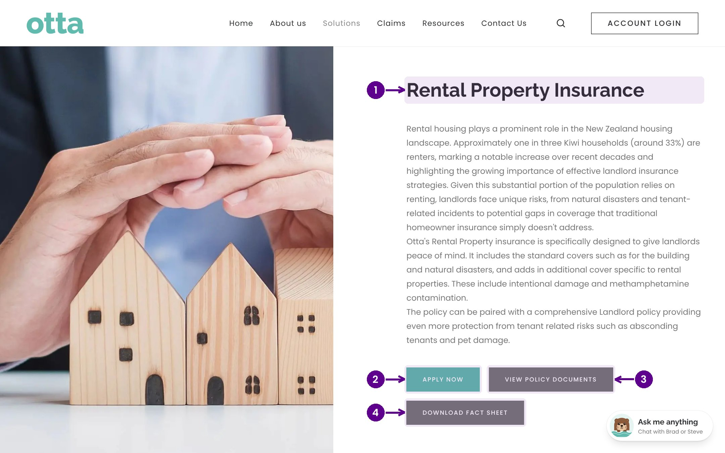
A product page
1
The product name and a plain English overview of who it is for.
2
Apply now starts an application (see the next slides).
3
View policy documents opens the wordings and forms for this product.
4
Download fact sheet gives a one page summary to share.
Notes:
Each product page opens with the product name and an overview. The buttons underneath are the main actions: Apply now, View policy documents, and Download fact sheet. The page used here is Rental Property Insurance, but every product page follows the same pattern.

Slide 10
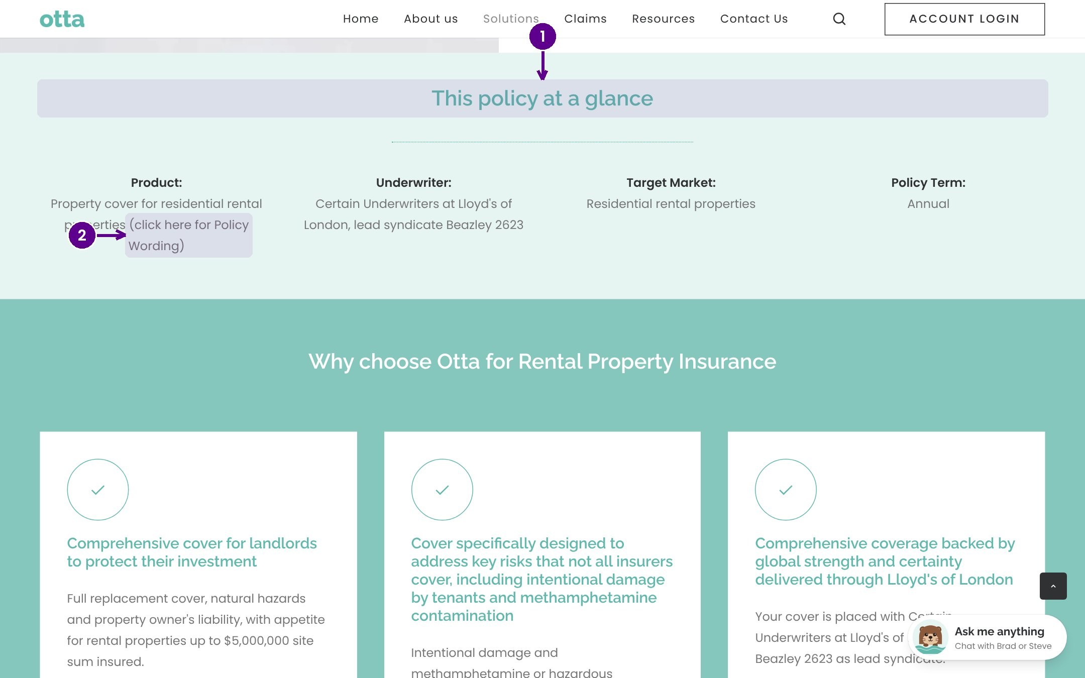
This policy at a glance
1
A quick summary of the main covers and features.
2
The link to the full policy wording, for the detail.
Notes:
Further down each product page is the policy at a glance section. It summarises the key covers. For the exact terms, follow the link to the policy wording.

Slide 11
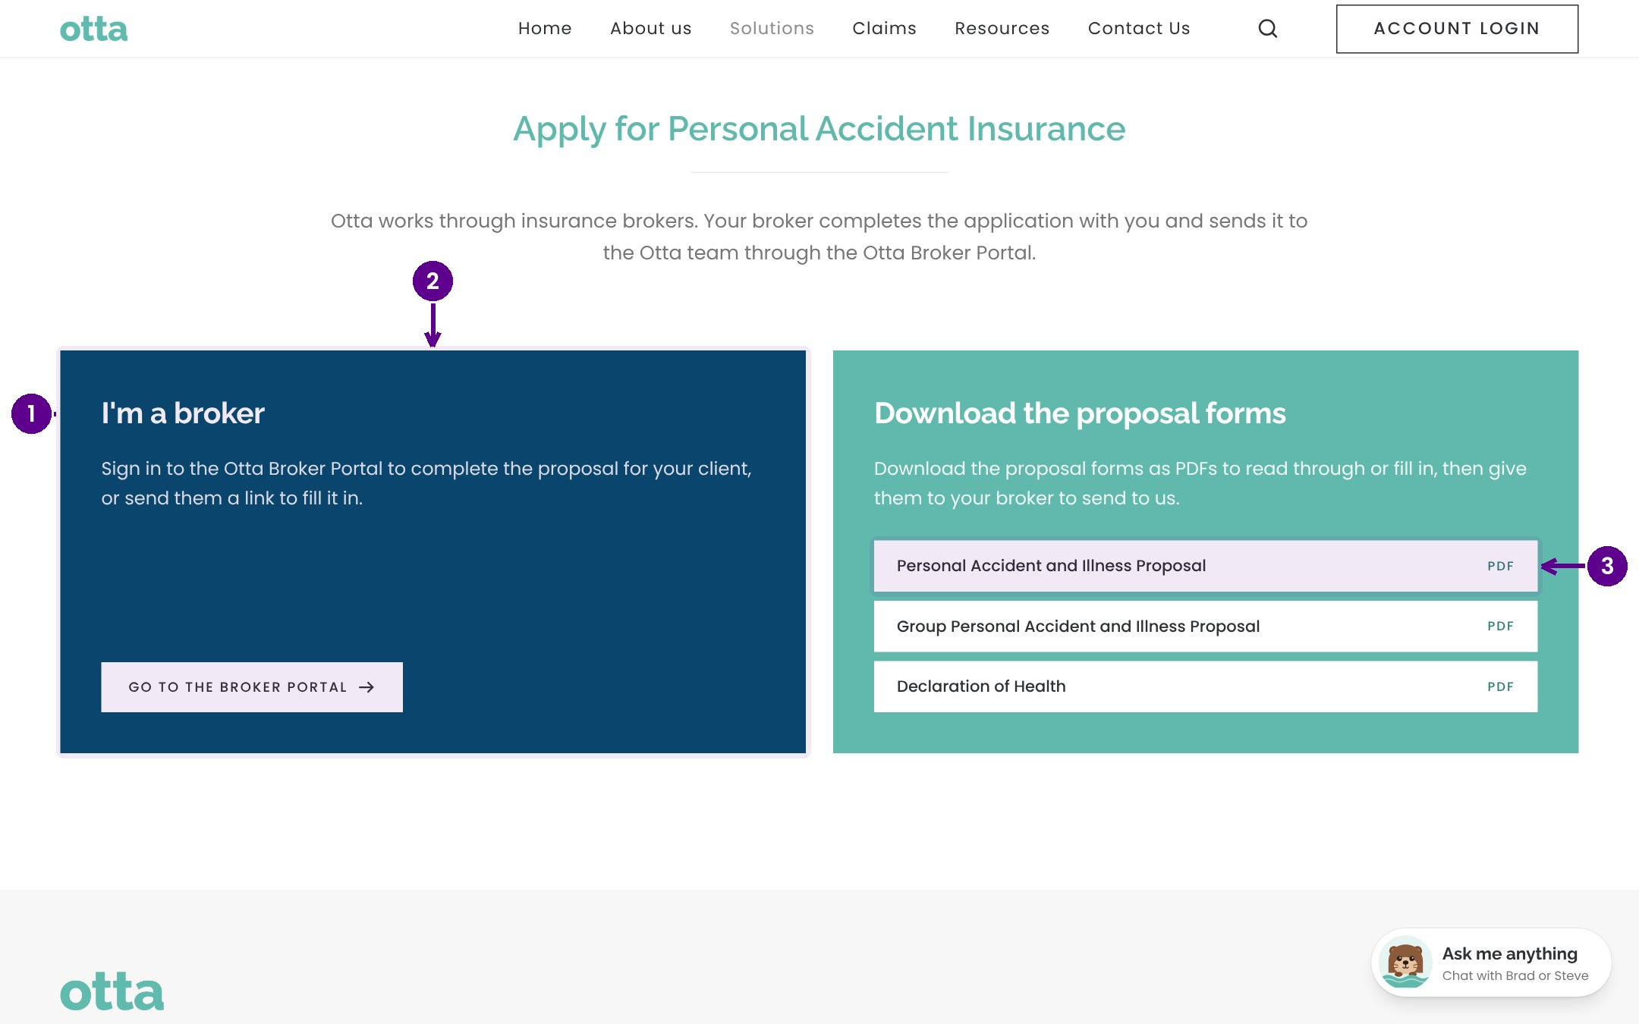
Apply now: only brokers can apply
1
Visitors confirm they are a broker. Only brokers can submit applications on behalf of clients.
2
Go to the broker portal to complete the form online or send it to a client.
3
Or download the PDF proposal form to complete and email to Otta.
Notes:
Otta works through brokers, so Apply now always starts by confirming the visitor is a broker. Brokers can then go to the broker portal, where they can complete the application online or send a secure link to their client. If they prefer paper, they can download the PDF proposal form. Members of the public are directed to talk to their broker.

Slide 12
Resources, claims and contact
04
Where visitors find documents, make a claim, or get in touch with the team.
Notes:
Resources, claims and contact. Where visitors find documents, make a claim, or get in touch with the team.

Slide 13
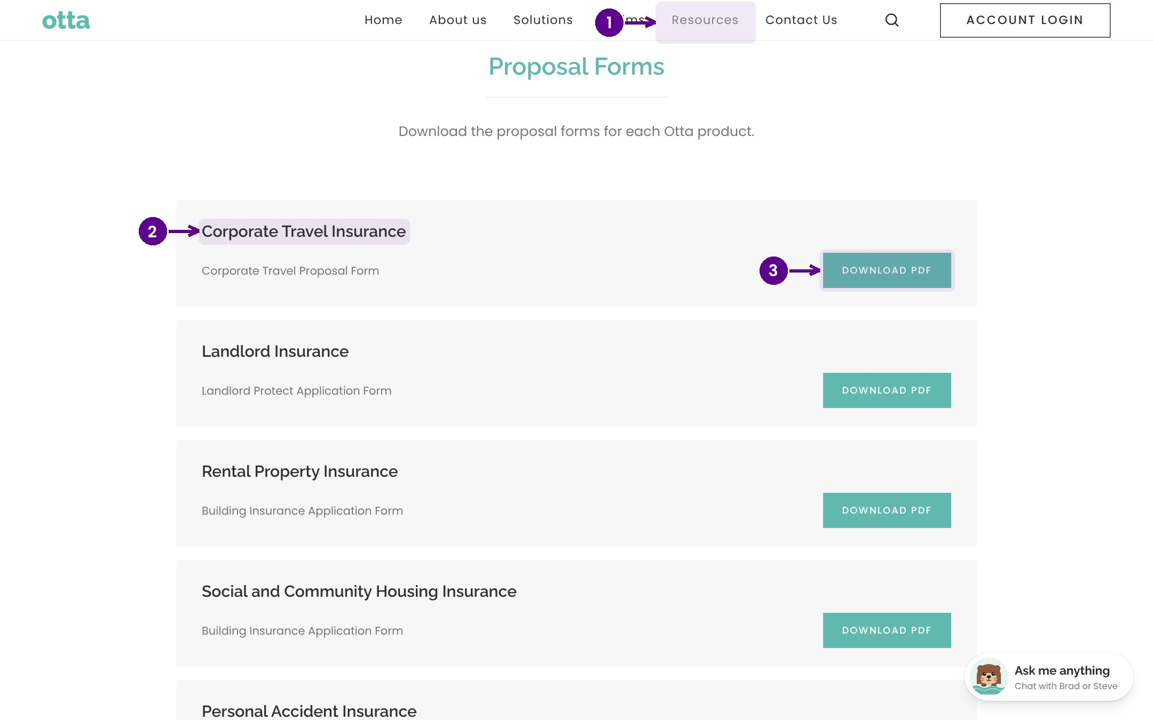
Resources: forms and policy wordings
1
Open Resources from the main menu.
2
Choose a product to see its documents.
3
Download PDF saves a copy of the form or wording.
Notes:
Resources holds every policy wording, fact sheet and form, grouped by product. Pick a product, then download the document you need.

Slide 14
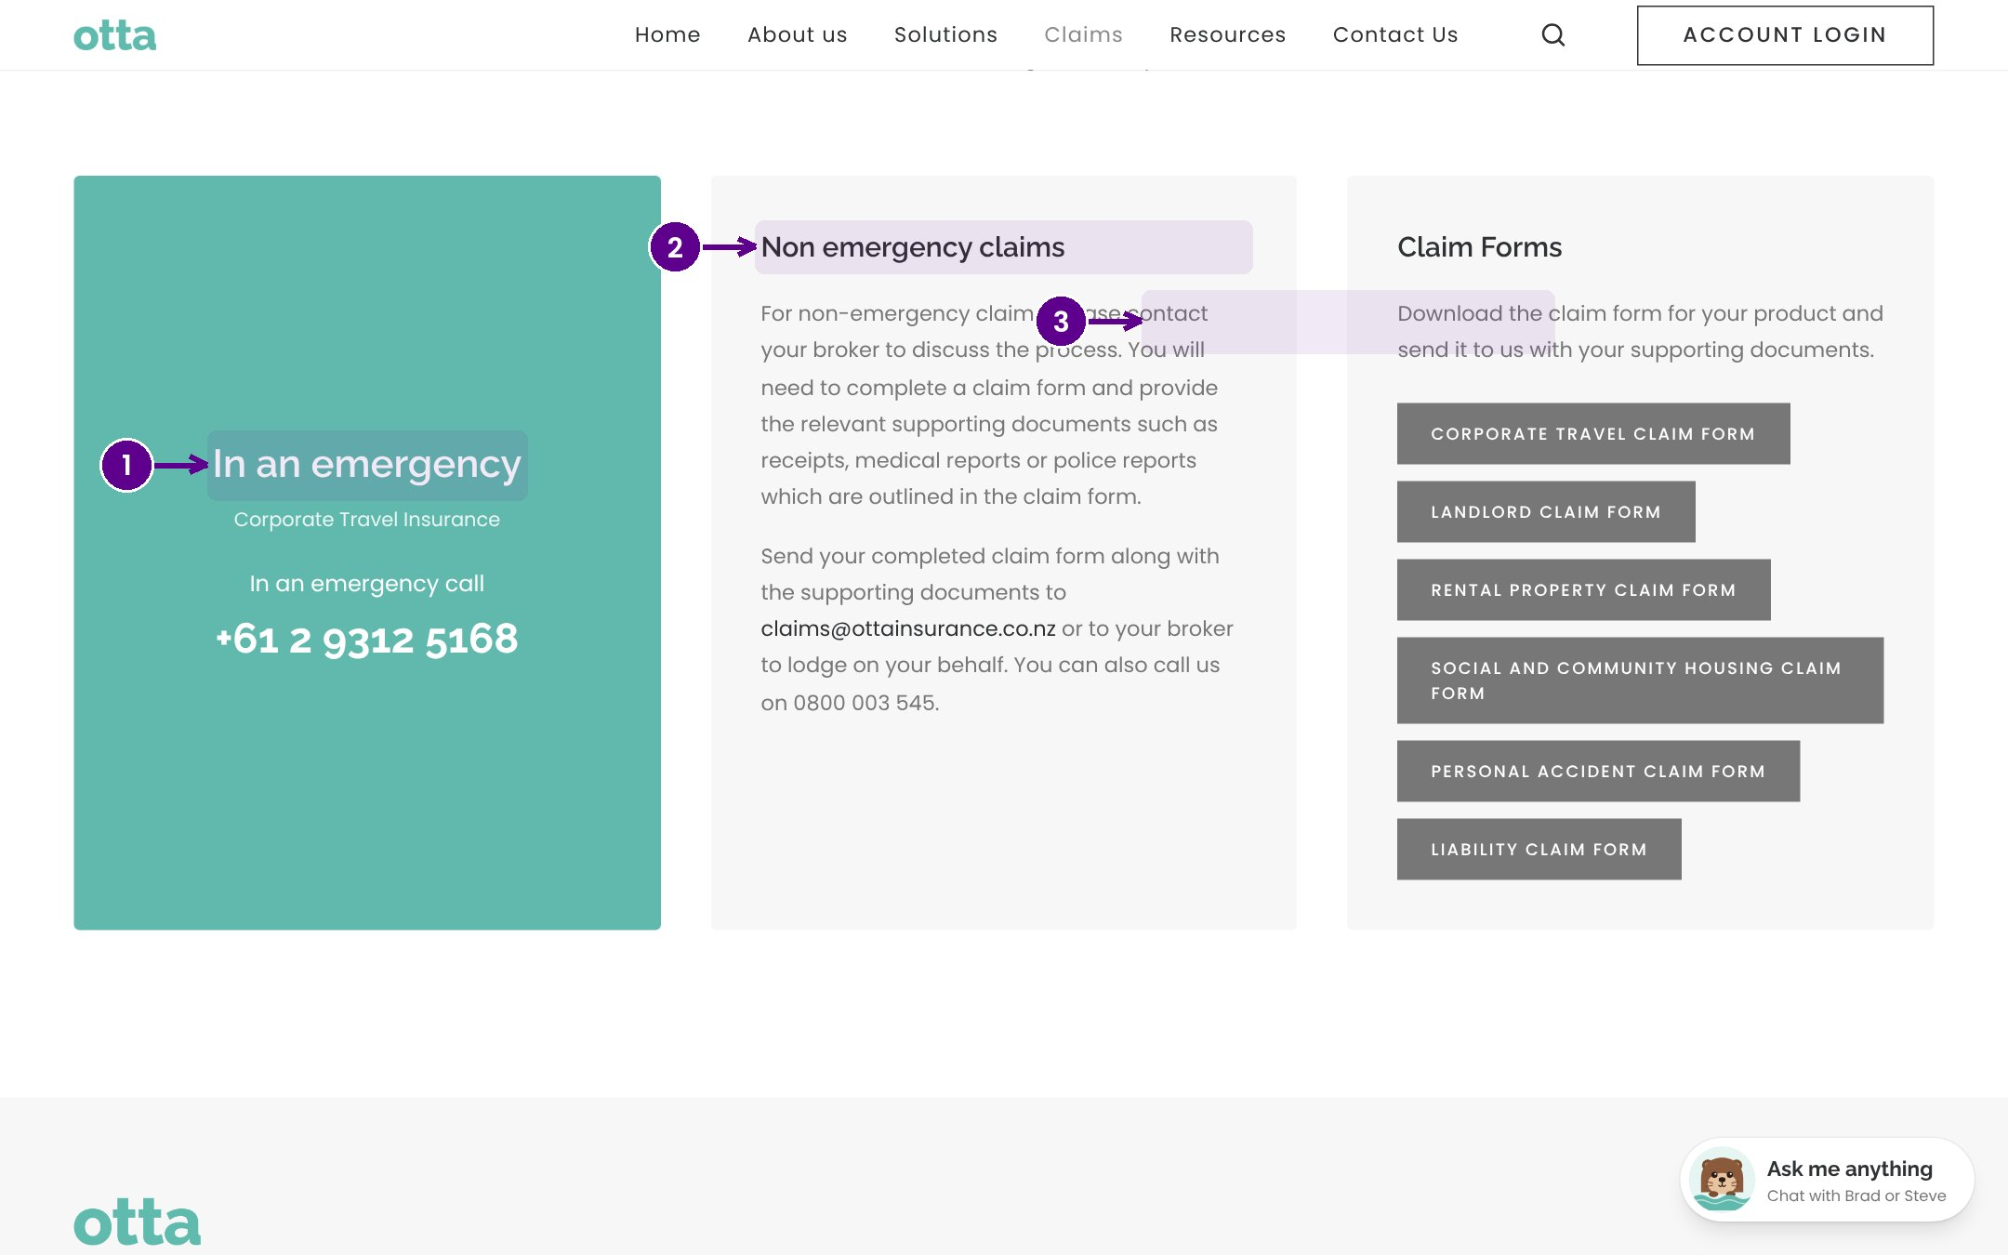
Making a claim
1
In an emergency: who to call straight away.
2
Non emergency claims: the steps to follow.
3
Claim forms for each product.
Notes:
The Claims page tells customers what to do in an emergency first, then how to lodge a non emergency claim, and links to the claim form for each product.

Slide 15
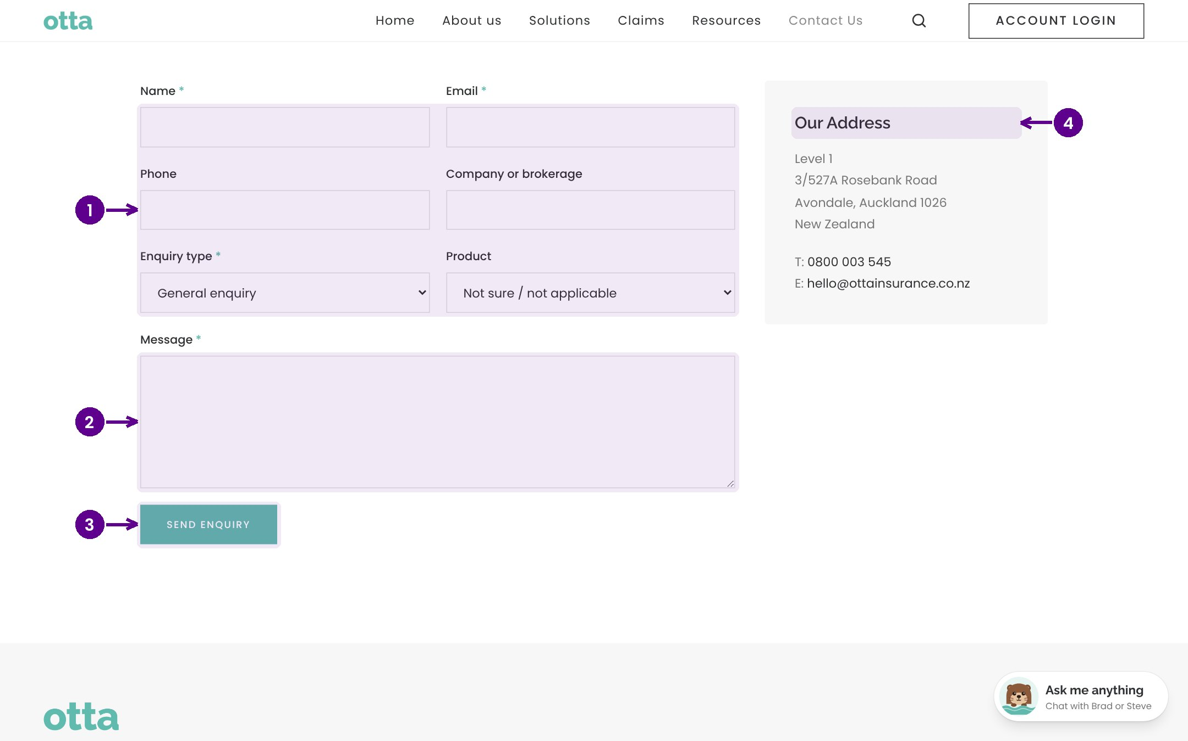
Contact us and enquiries
1
The visitor's details and the product they're asking about.
2
Their message.
3
Send enquiry: it appears in the admin portal under Enquiries and is emailed to the team.
4
Our address, phone number and email.
Notes:
The Contact Us form is the main way visitors get in touch. When someone selects Send enquiry, it is saved in the admin portal under Enquiries, it pops up on the admin dashboard, and it is emailed to the team. The page also lists our address and phone number.

Slide 16
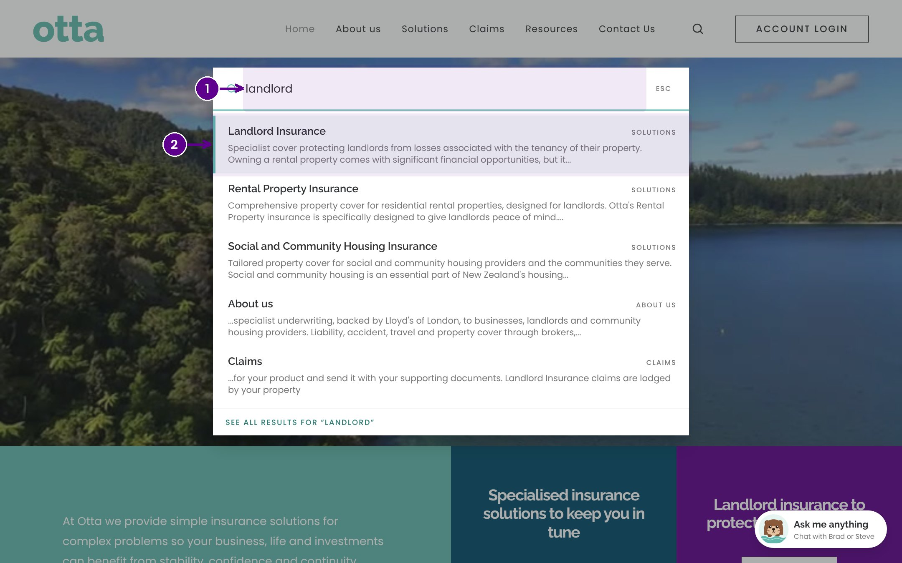
Searching the site
1
Select the magnifying glass and start typing.
2
Choose a result to go straight to it.
Notes:
Search looks across products, forms and pages. Results appear as you type. Select one to go straight there.

Slide 17
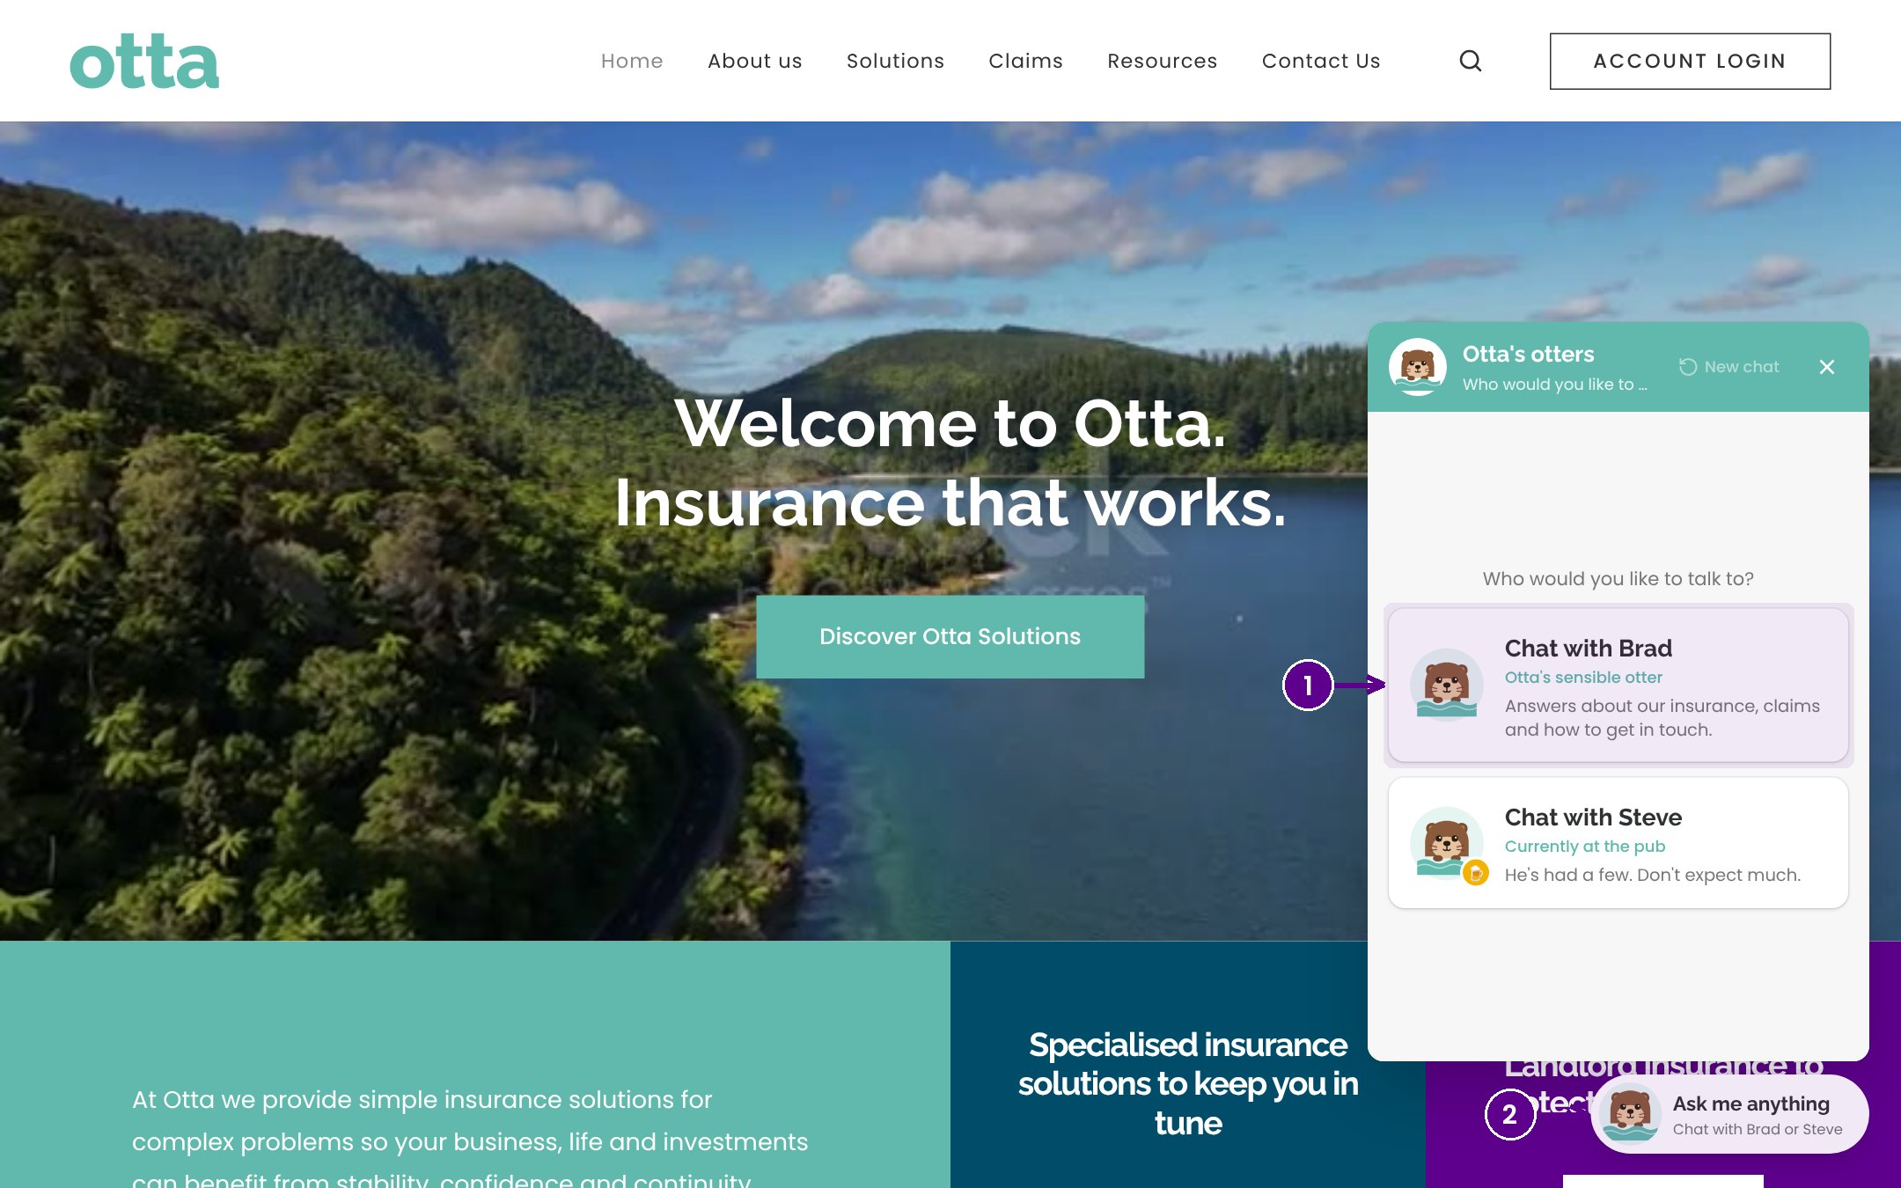
The website chat
1
Brad answers questions about our insurance, claims and how to get in touch.
2
Steve is Brad's off duty mate, just for fun.
Notes:
The otter in the corner opens the website chat. Brad is an AI assistant that gives general information about our products, claims and contact details. It does not give advice. Steve is a light hearted extra and points people back to Brad.

Slide 18
Key points
The header, logo and main menu are the same on every page.
✓
Products live under Solutions. Each has Apply now, policy documents and a fact sheet.
✓
Only brokers can apply on behalf of clients: online in the portal or with the PDF form.
✓
Enquiries from Contact Us arrive in the admin portal and by email.
✓
Notes:
Key points. The header, logo and main menu are the same on every page. Products live under Solutions. Each has Apply now, policy documents and a fact sheet. Only brokers can apply on behalf of clients: online in the portal or with the PDF form. Enquiries from Contact Us arrive in the admin portal and by email.

